Slide 1


Computational Investigation of CO₂ Adsorbed Coronene Using DFT
Under the Guidance of Dr. S. VIJAYAKUMAR
Associate Professor
Department of Medical Physics
Bharathiyar University,
Coimbatore - 46
Under the Mentorship of Dr. J. KALYANA SUNDAR
Assistant Professor
Department of Physics
Periyar University,
Salem - 11
Presented by
MALLESH J (U24PG521PHY016)
M.Sc Physics
Periyar University,
Salem -11

Slide 2
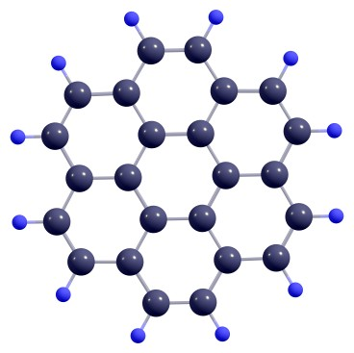
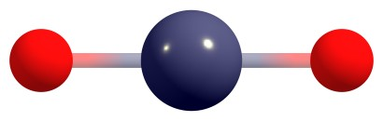
Introduction & Motivation
The Global Problem: Rising carbon dioxide emissions are a primary driver of climate change.
A Potential Solution: Polycyclic Aromatic Hydrocarbons (PAHs), like coronene, are promising materials for CO₂ capture.
Why Coronene?
It's a planar molecule C₂₄H₁₂ made of seven fused benzene rings.
Its extensive π -electron system makes it an ideal model for studying gas adsorption.
Coronene as a Graphene Analog:
It serves as a finite-size model for graphene sheets.
It allows for the study of π -conjugated electronic structures found in larger nanomaterials.
CO₂
Coronene

Slide 3
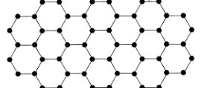
Introduction & Motivation
CO₂
Graphene
Coronene

Slide 4
Objectives
The goal of this work is to analyze the CO₂-coronene interaction using DFT.
Geometric Analysis: To determine the optimal adsorption structure and measure bond distortions.
Electronic Investigation: To analyze the changes in the HOMO-LUMO gap, Density of States (DOS), and polarizability.
Energetic Characterization: To calculate the adsorption energy (E_{ads}).
Mechanism Classification: To identify the type of adsorption (Physisorption vs. Chemisorption).

Slide 5

Why Computational Chemistry?
Guiding Experiments: Computational predictions (e.g., properties of graphene) have often preceded and guided experimental discovery.
Enabling the "Impossible": These methods are essential for innovation, allowing us to model experiments that are impractical or impossible to perform physically.
Our Focus: We use computational physics and chemistry for molecular design, providing detailed insights without physical experiments.
CLUSTER COMPUTER

Slide 6

Key Concepts & Softwares

Slide 7
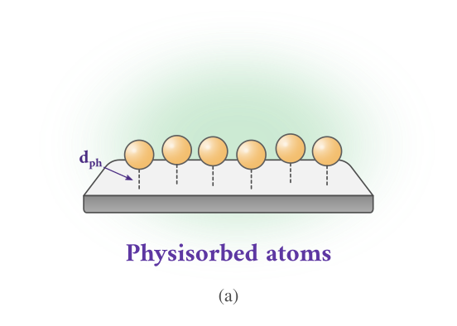
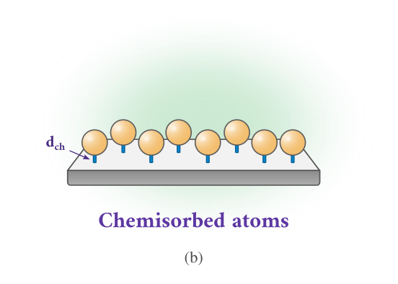
Adsorption Concepts
Adsorption is the process by which atoms, ions, or molecules from a gas, liquid, or dissolved solid adhere to the surface of a material.
There are two types of Adsorption:
Weak van der Waals,
Reversible
dph= >3 Å.
Strong covalent bond,
specific,
dph=<1.5 Å.

Slide 8
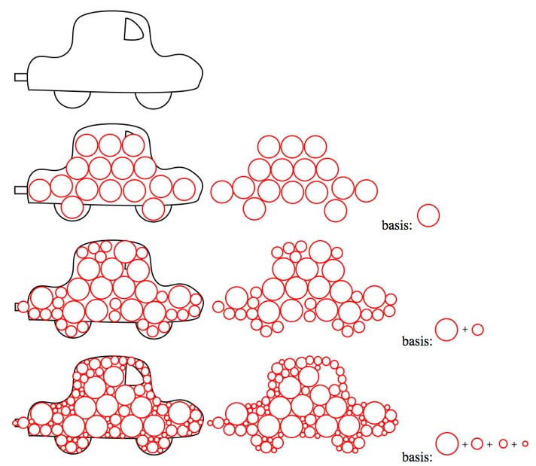
Basis Sets and Functional
Basic Sets
A basis set is a collection of mathematical functions used in quantum chemistry to approximate the electronic wave function and model molecular orbitals of atoms and molecules
Basis sets express orbitals as linear combinations.
Functional
A functional in quantum chemistry, especially in density functional theory (DFT), is a mathematical expression that relates the electron density of a system to its total energy, enabling the calculation of molecular properties.

Slide 9
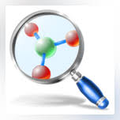

Software Used
ChemCraft: Used for structure building and visualization..
It is a graphical program used for visualizing and analyzing quantum chemistry calculation results, enabling users to view molecular structures, manipulate geometries, and prepare publication-quality images
Gaussian: Used for DFT calculations.
It is a widely used computational chemistry software package that predicts molecular energies, structures, and properties using quantum mechanical calculations

Slide 10
METHADOLOGY

Slide 11
Computational Procedure
DESIGNING A MOLECULE
Our Workflow:
DESIGN: Build the Coronene and CO₂ structures in ChemCraft.
OPTIMIZE: Calculate the minimum energy structures (bare and complex)
COMPARE: Analyze the changes in geometry, electronics, and energy
CONCLUDE: Classify the interaction.
Calculation Details:
Functional: B3LYP (A hybrid functional for balanced accuracy).
Basis Set: 6-31G(d) (A split-valence set with 'd' polarization functions for accuracy).
Corrections: Counterpoise correction was applied to correct for Basis Set Superposition Error (BSSE).
OPTIMIZING (STRUCTURE & ENERGY)
COMPARING WITH BARE STRUCTURE
CONCLUSION

Slide 12
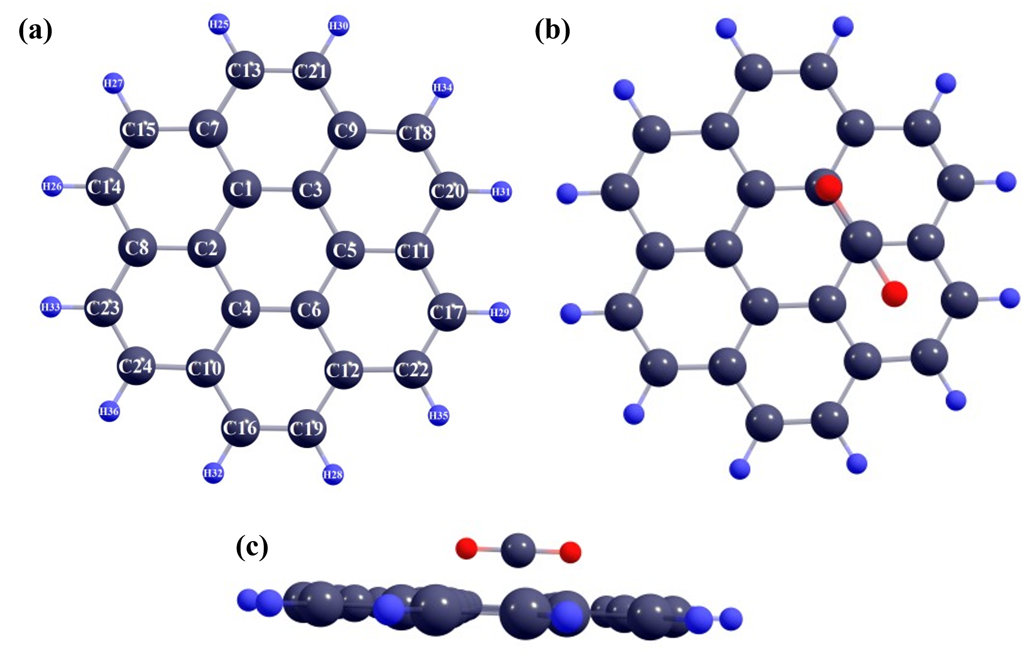
Computational Procedure
Structures optimized using B3LYP/6-31G(d).
SCF convergence via xqc option in Gaussian.
Counterpoise correction for BSSE applied.
Electronic structure via DOS and HOMO-LUMO.
Preparation for adsorption
Optimized coronene.
CO₂ placed near the coronene.
Side view of CO₂ placed near the coronene

Slide 13
RESULT AND DISCUSSION

Slide 14
Observations
Initial State:
CO₂ is placed above the central ring of the planar coronene molecule
Final (Optimized) State:
The CO₂ molecule binds strongly, distorting the coronene structure
The CO₂ molecule itself becomes non-linear, bending to an angle of 128.907°.
Adsorption Height:
The CO₂ Carbon is 1.575 Å above the C5 carbon of coronene.
The O1 oxygen is 1.523 Å above the C3 carbon.
This short distance (1.549 Å avg) is characteristic of chemisorption.

Slide 15
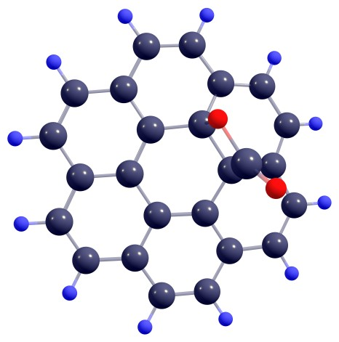
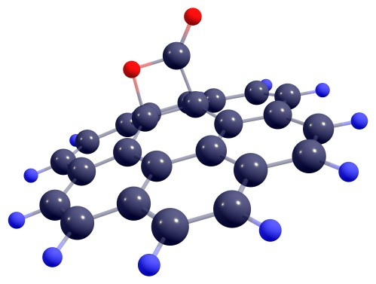
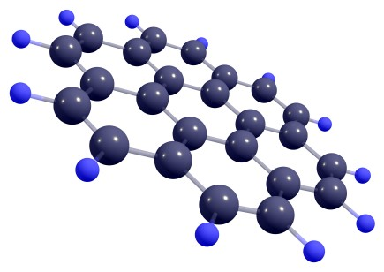
Comparison of Coronene before and after the Adsorption
BEFORE
AFTER
UPPER
VIEW
LATERAL
VIEW

Slide 16
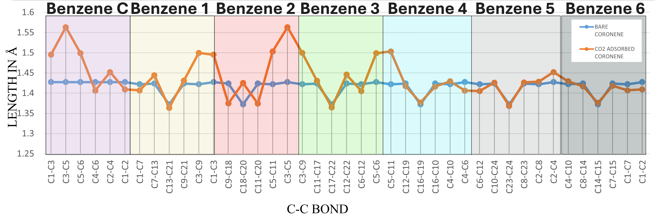
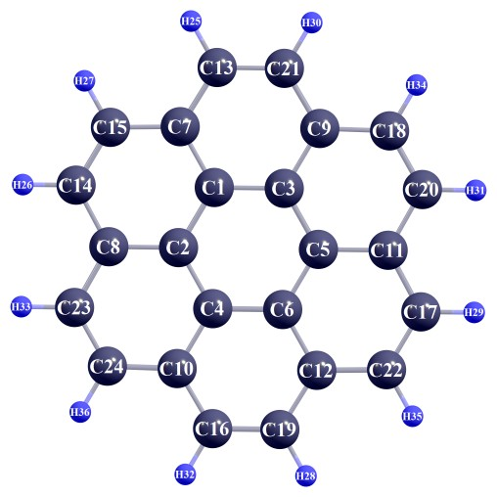
Bond Length Analysis
Adsorption causes significant structural distortion, especially in the central rings (Benzene C and 2).
Key Changes:
The C3–C5 bond in coronene lengthens by ~9.5%.
The C-O1 bond in the CO₂ molecule lengthens by ~14%.
C–H bonds remain relatively unchanged
Implication:
This significant bond stretching confirms a strong, localized chemical interaction, not just weak physisorption

Slide 17
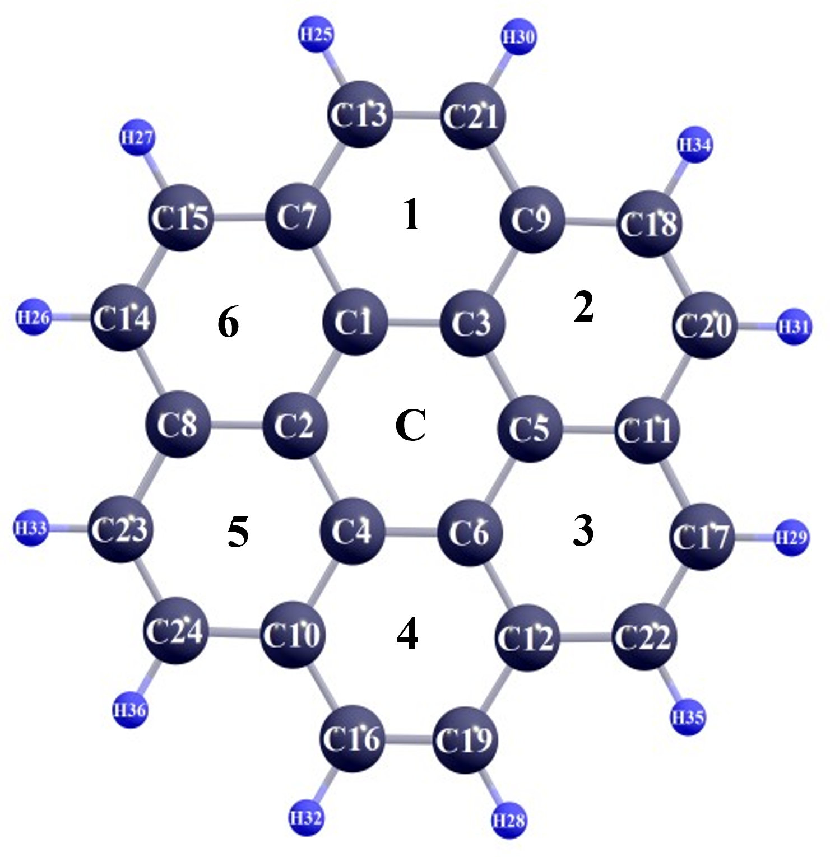
Bond Length Analysis

Slide 18
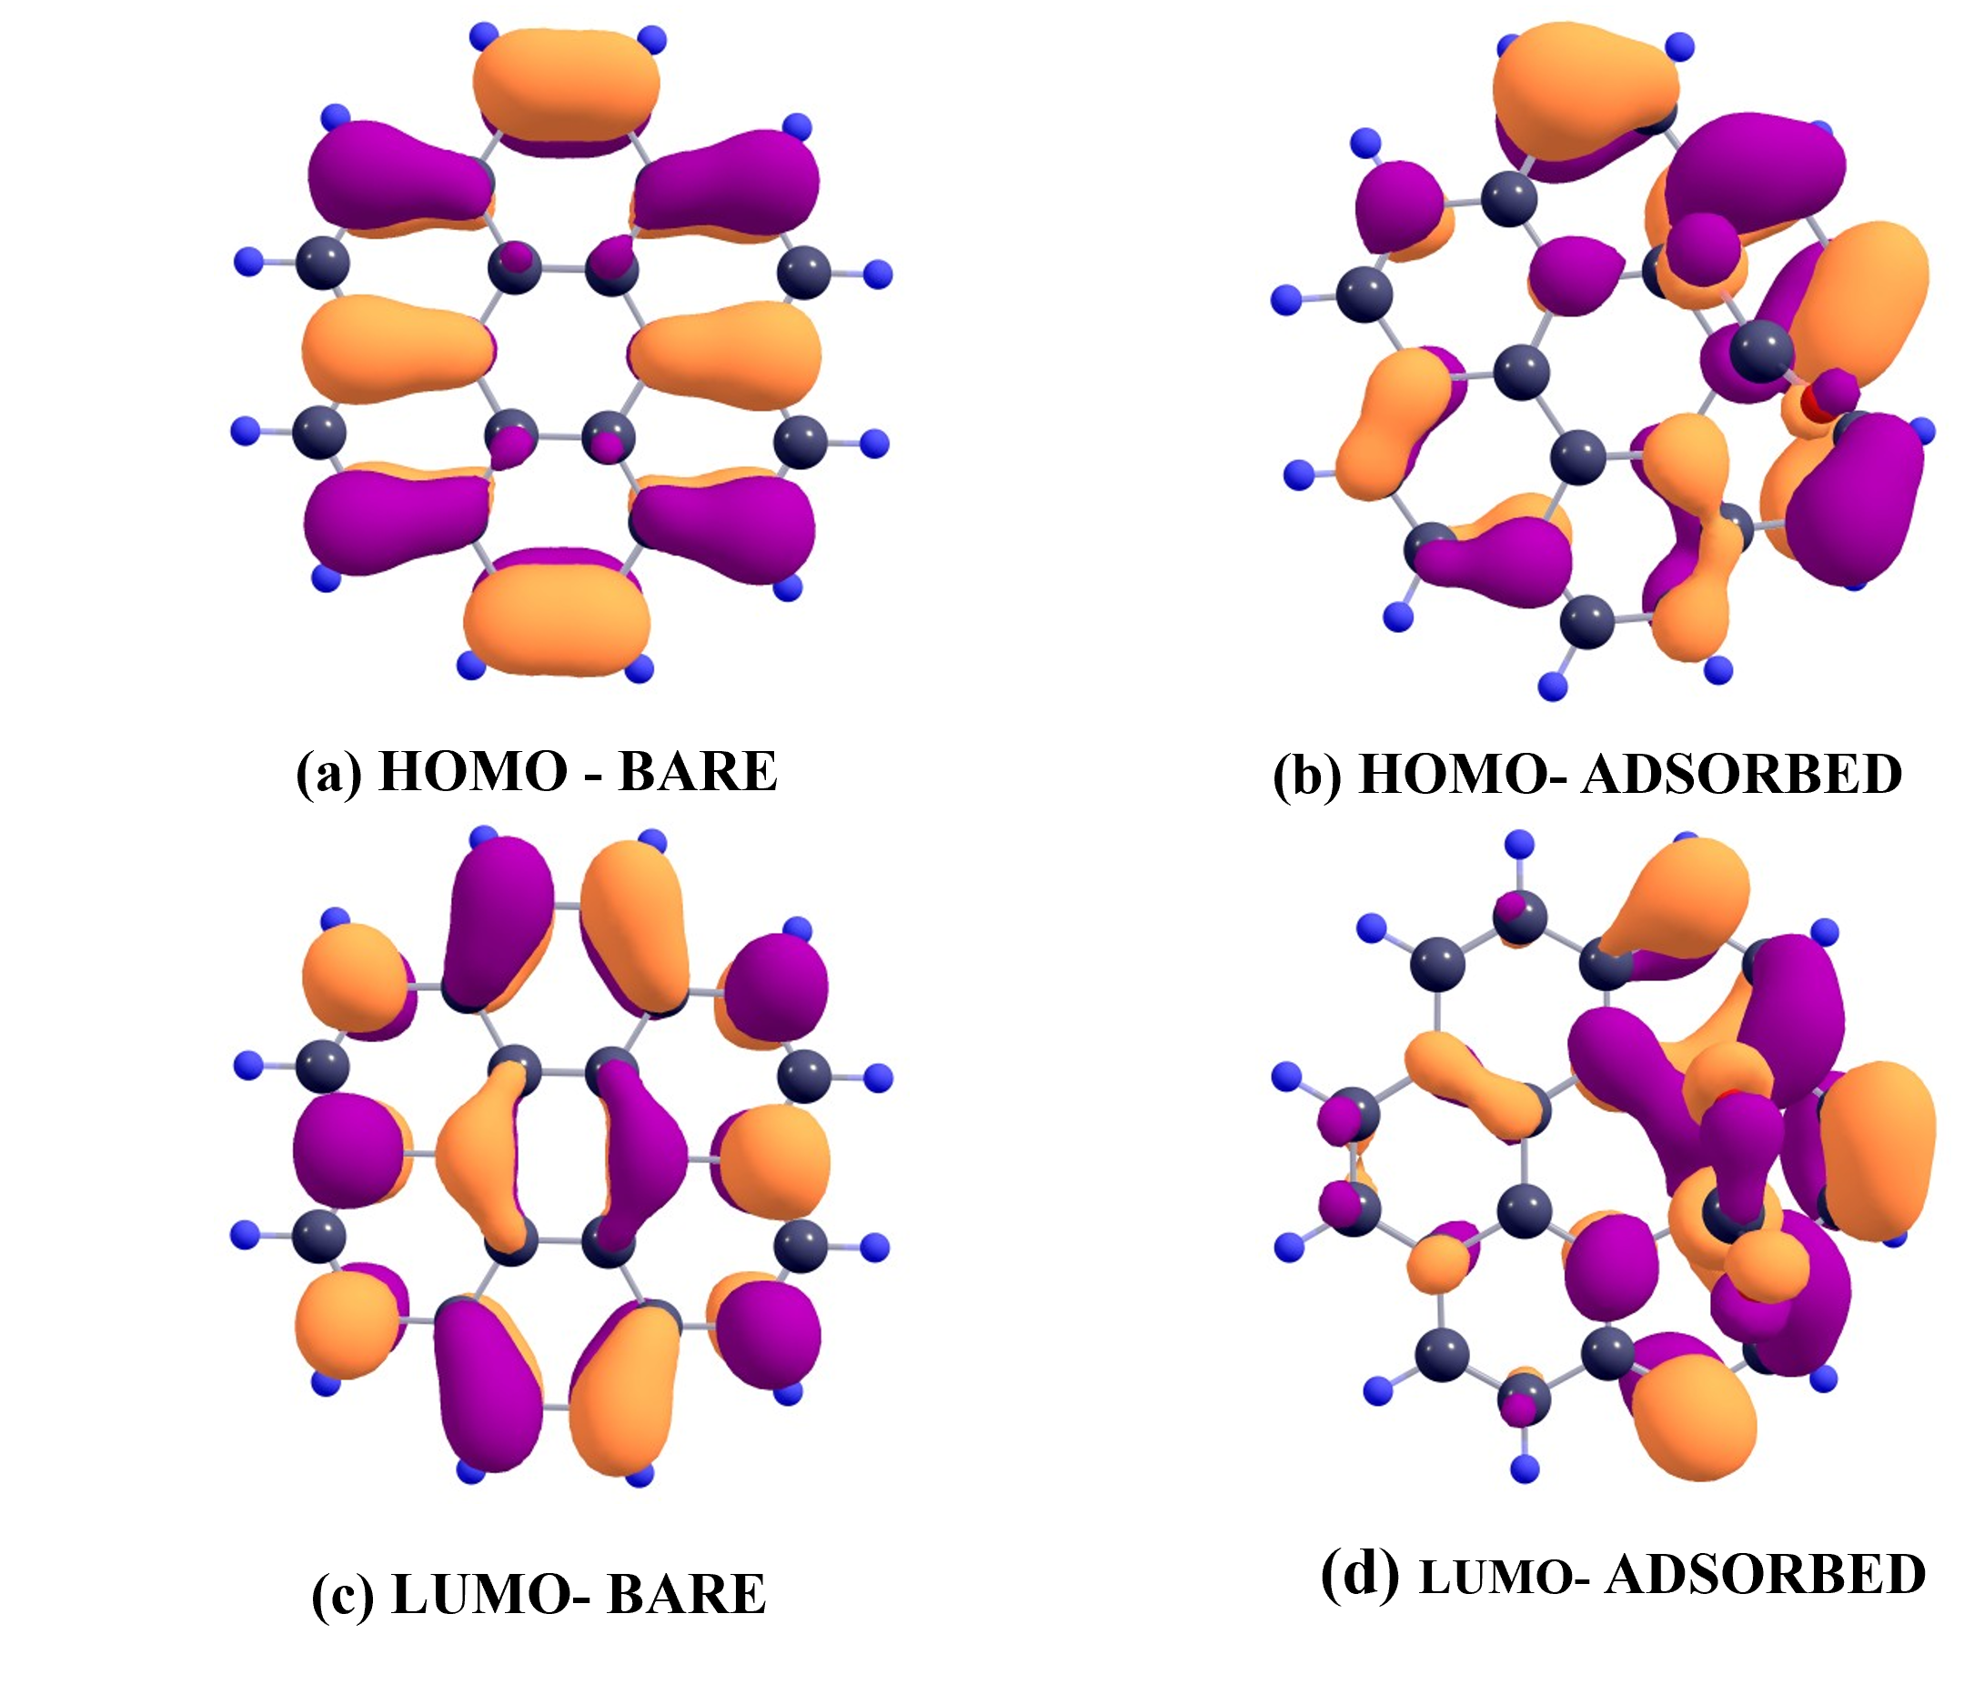
Electronic Properties
A dramatic change in the electronic structure was observed.
HOMO-LUMO Gap:
Bare Coronene: 4.035 eV.
CO₂ Adsorbed Complex: 2.896 eV
Implication:
This is a 28% reduction in the energy gap.
A smaller gap suggests enhanced electronic conductivity and higher chemical reactivity..
The LUMO shifts significantly downward, indicating electron density transfer from coronene to CO₂

Slide 20
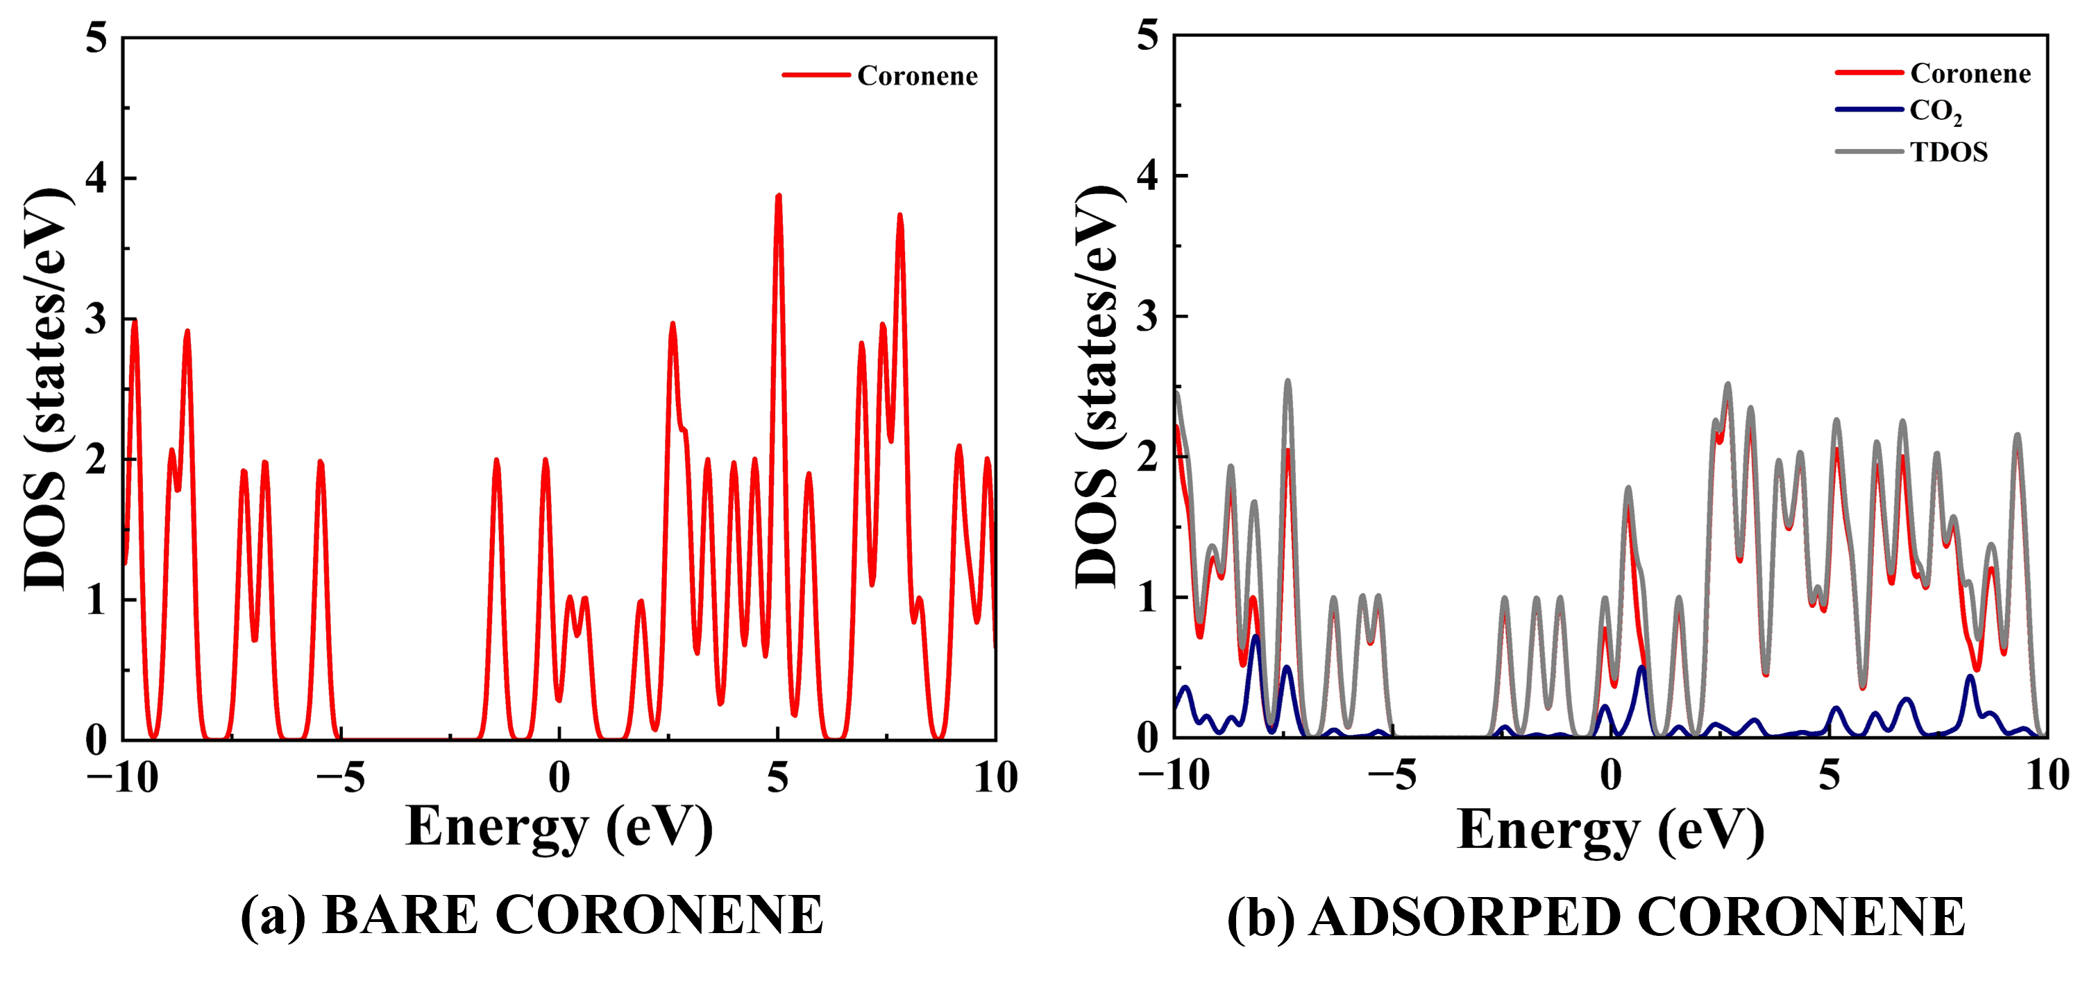
Orbital and DOS Changes
Density of States (DOS):
The DOS plots confirm the HOMO-LUMO gap narrowing.
The frontier orbitals (near the gap) become localized at the binding site, showing orbital redistribution.

Slide 21
Orbital and DOS Changes

Slide 22
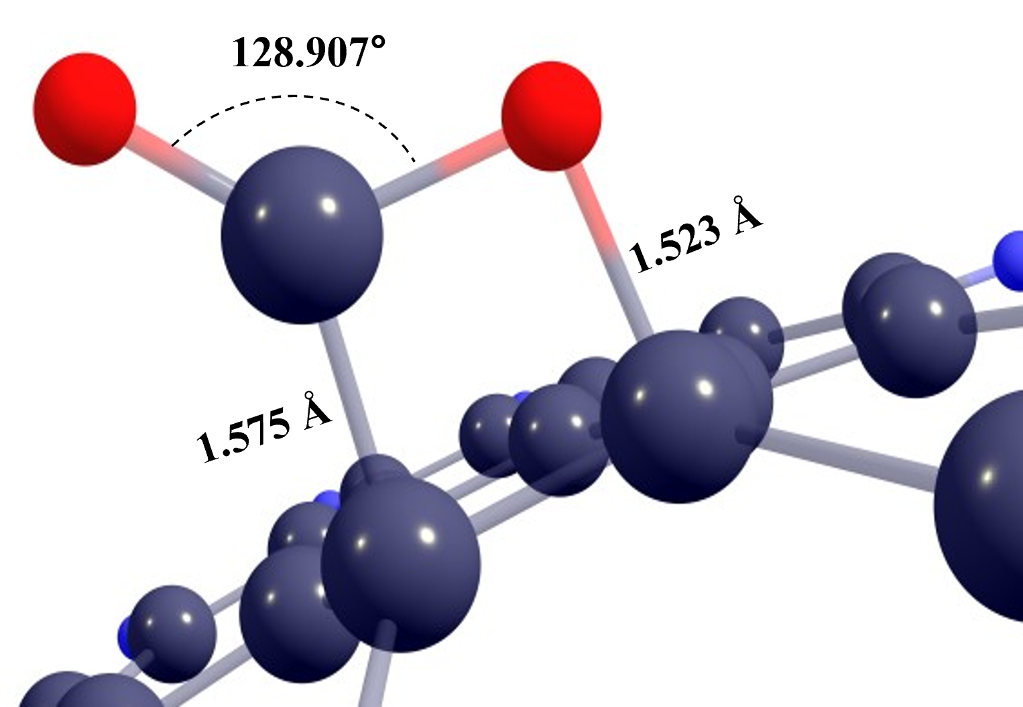
Polarizability and Geometry
Polarizability:
The polarizability of the complex increases by 7.47%.
This indicates a greater electronic response and stronger intermolecular interaction.
Final (Optimized) State:
The CO₂ molecule binds strongly, distorting the coronene structure.
The CO₂ molecule itself becomes non-linear, bending to an angle of 128.907°.
Adsorption Height:
The CO₂ Carbon is 1.575 Å above the C5 carbon of coronene.
The O1 oxygen is 1.523 Å above the C3 carbon.
This short distance (1.549 Å avg) is characteristic of chemisorption.

Slide 23
Adsorption Energy and Mechanism
Adsorption Energy (E_{ads}):
E_{ads} = E_{complex} – E_{coronene} – E _{CO2}
E_{ads} = -30213.44 - (-25083.85) - (-5128.71) = -0.880 eV
Energetics:
The energy is -0.880 eV (or ~85 kJ/mol).
The negative value means the adsorption is exothermic and thermodynamically favorable.
Mechanism Classification: Weak Chemisorption
The energy (85 kJ/mol) is in the chemisorption range (80-240 kJ/mol).
This is supported by the short adsorption distance (1.549 Å), significant bond distortion , and CO₂ bending.
It is "weak," which is ideal for CO₂ capture, as it suggests potential reversibility.
Complex energy (eV) | Adsorbate energy (eV) | Adsorbent energy (eV) | Adsorption energy (eV)
-30213.44008 | -5128.714785 | -25083.84569 | -0.879605009

Slide 24
Conclusion
This DFT study confirms that CO₂ adsorbs onto coronene via weak chemisorption with a favorable energy of -0.880 eV
The adsorption is characterized by significant structural and electronic changes
Structural: The CO₂ molecule bends (128.9°), and C-C / C-O bonds are significantly distorted
Electronic: The HOMO-LUMO gap is reduced by 28% (to 2.896 eV), and polarizability increases by 7.47%
The interaction site is localized at the central benzene ring, with the CO₂ molecule bridging two carbon atoms (C3 and C5)
These findings provide valuable insights for designing new PAH-based materials for practical carbon capture applications

Slide 25
THANK YOU

